Slide 1

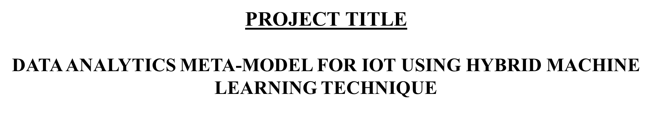
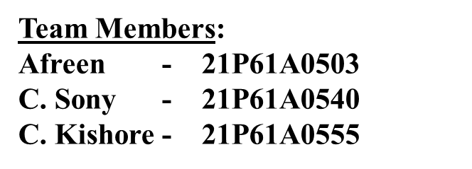
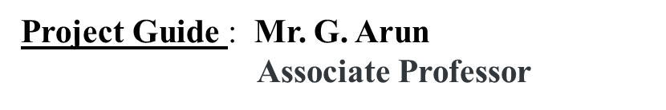

Slide 2
ABSTRACT
The increasing amount of IoT data raises concerns about data privacy and network costs, necessitating innovative solutions for predictive analytics.
A hybrid machine learning framework combining Adaptive Moving Window Regression (AMWR) and Federated Learning (FL) is proposed to analyze historical and real-time dynamic IoT data.
The framework aims to address the limitations of existing IoT data analysis methods
Improving data privacy, reducing network costs, and enabling efficient training on devices of Deep Neural Networks.
Improved prediction accuracy, and enhanced predictive precision for complex events, improve treatments for diseases without needing invasive procedures.
KEYWORDS
Hybrid Machine Learning Framework, Adaptive Moving Window Regression (AMWR), Federated Learning (FL) Predictive Analytics, Data Privacy, Network Costs, Historical Data Analysis, Predictive Accuracy, Non-invasive Disease Treatment.

Slide 3
INTRODUCTION
Internet of Things (IoT) devices generates extensive data, crucial for predictive analytics.
Traditional cloud-based data analysis faces challenges related to privacy and network costs
Existing models : Cloud-Centric IoT Data Analysis, rely on centralized cloud servers for processing and analysis concerns about data privacy and network costs
Edge Computing with Limited AI, where data processing is done locally on the IoT device or a nearby edge server, rather than in the cloud.
Centralized Predictive Models, commonly used in healthcare, train on large datasets in a single location, but may not adapt to dynamic IoT data streams.

Slide 4
LITERATURE SURVEY
TOPICS | KEY CONTRIBUTIONS | SUMMARY | LIMITATIONS
Federated Learning (FL) in Healthcare | Rieke et al. (2020) demonstrate FL's role in medical imaging, showing that multiple healthcare institutions can collaborate without sharing sensitive data [1]. Xu et al. (2021) propose an FL framework for wearable healthcare devices, ensuring privacy and reducing communication costs for real-time patient monitoring [2]. | FL in healthcare enables secure and decentralized data processing, allowing IoT devices to perform model training locally, ensuring privacy and reducing network overhead. | Interoperability and data management issues Resource constraints (battery life, processing power)
Adaptive Moving Window Regression (AMWR) for Dynamic Data Analysis | Gao et al. (2022) explore dynamic window strategies in health data time-series analysis, improving prediction accuracy in non-invasive health systems [3]. Zhou et al. (2022) introduce an AMWR framework that integrates historical and real-time data, enhancing the accuracy of wearable health monitoring systems [4]. | AMWR adapts to real-time and historical data, making it effective for healthcare environments requiring quick, accurate responses. | AMWR framework require constant tuning, which adds complexity and demands higher computational power. These models can be sensitive to noisy or incomplete data, affecting the accuracy of health monitoring systems.

Slide 5
TOPIC | KEY CONTRIBUTIONS | SUMMARY | LIMITATION
IoT in Healthcare and Data Privacy Concerns | Nguyen et al. (2021) focus on security challenges in IoT healthcare devices, emphasizing how FL can protect patient privacy while processing data locally [5]. Sadat et al. (2022) propose a privacy-preserving FL framework for IoT healthcare systems, minimizing communication costs while ensuring predictive accuracy [6]. | Data privacy in IoT healthcare systems is crucial, and FL offers a solution by allowing decentralized model training that minimizes data sharing. | Scalability issues and resource constraints can limit the effectiveness of security measures for a large number of IoT devices. The privacy-preserving framework may still face scalability challenges and high resource demands, potentially affecting system performance.
Complex Event Processing (CEP) in Healthcare | Maddouri et al. (2021) integrate CEP with machine learning for predictive analytics in IoT-based healthcare systems, enhancing event detection by incorporating historical data [7]. Chatterjee et al. (2022) present a CEP-enhanced predictive model that continuously monitors patient health, reducing the need for invasive methods [8]. | CEP, when combined with machine learning models like FL and AMWR, improves real-time event detection and predictive power for healthcare IoT systems. | Combining CEP with machine learning is complex and can be expensive. Constant health monitoring needs a lot of computing power and may be hard to set up in environments with limited resources.

Slide 6
PROBLEM STATEMENT
“ Design and develop a hybrid machine learning framework that integrates Federated Learning (FL) and Adaptive Moving Window Regression (AMWR) to predict diseases non-invasively in IoT-enabled healthcare systems.”
OBJECTIVE
Develop a hybrid machine learning framework that integrates Federated Learning (FL) and Adaptive Moving Window Regression (AMWR) for prediction.
Ensure data privacy and security by leveraging FL's decentralized architecture.
Improve prediction accuracy and adaptability to dynamic IoT data streams using AMWR.

Slide 7
SYSTEM SPECIFICATION REQUIREMENTS
SOFTWARE REQUIREMENTS:
Operating System : Linux (Ubuntu, CentOS) or Windows
Programming Languages : Python
Libraries & Frameworks : Machine Learning: TensorFlow, Scikit-learn, KMeans, Ridge Regression Data Processing: Pandas, NumPy
Visualization: Matplotlib, IPython for displaying results
Data Scaling: StandardScaler
Database Management System
Integrated Development Environment :GOOGLE COLAB/ PyCharm / Visual Studio Code/ Eclipse
HARDWARE REQUIREMENTS
CPU : Multi-core processors
GPU(Graphics Processing Unit) : Mid-range GPUs
RAM : 64GB to 128GB
Storage : Minimum 32GB
Sensors and Actuators

Slide 8
EXSISTING SYSTEM
Cloud-Based Predictive Models:
IoT data is sent to cloud servers for centralized processing.
Microsoft Azure IoT Hub: Cloud service that connects, monitors, and manages IoT devices on Microsoft Azure.
Pros: High computational power, advanced machine learning algorithms.
Limitation: Data privacy concerns, high network and storage costs.
Federated Learning (FL) Models:
Decentralized approach that trains models locally on IoT devices.
Google’s Gboard: A real-world example where FL is used for predictive text without sending user data to central servers.
Pros: Enhances privacy, reduces data sharing.
Limitation : Computational and communication challenges on resource-limited devices.
Edge Computing Models:
Edge computing processes data locally on or near the IoT device, instead of sending it to a central cloud server.
A smart thermostat in your home uses edge computing to instantly adjust the temperature based on your movements and preferences, without needing to send data to the cloud.
Pros: Reduces latency, real-time decision-making.
Limitation: Limited computational resources.

Slide 9
PROPOSED SYSTEM
Federated Learning (FL):
Function: Train machine learning models on local IoT devices to ensure data privacy and reduce network costs.
Optimization Strategies:
Structured Pruning : Reduces the size of the model.
Weight Quantization : Compresses model weights to maintain accuracy.
Selective Updating : Updates only parts of the model that which are in use.
Adaptive Moving Window Regression (AMWR) :
Function: Enhances prediction accuracy by integrating historical data with real-time updates.
Useful for applications requiring continuous adaptation to changing data patterns.
Complex Event Processing (CEP)
Function: Monitors real-time data streams to detect complex patterns and events.
Integration with AMWR and FL: CEP will provide immediate event detection,
while AMWR refines predictions using historical and real-time data.
FL will ensure that models are trained securely and efficiently.

Slide 10
PROPOSED METHODOLOGY
The proposed hybrid machine learning framework begins with data collection.
The collected data is then preprocessed to handle missing values, noise, and inconsistencies
Next, Federated Learning (FL) is implemented to train a global model by aggregating local updates from multiple devices without sharing sensitive data.
To optimize the FL process, a three-stage pipeline structured pruning, weight quantization, and selective updating to make FL more efficient.
Analyze and predict complex events using both historical and real-time data.
Combine FL and AMWR to enhance prediction accuracy and make the most of both types of data.
Use popular Deep Neural Networks (DNNs) and publicly available datasets to train and evaluate the hybrid model.
The performance of the hybrid model will be evaluated in terms of: Prediction accuracy, Data privacy, Network costs

Slide 11
MODULES
Federated Learning (FL):
Function: Train machine learning models on local IoT devices to ensure data privacy and reduce network costs.
Optimization Strategies:
Structured Pruning : Reduces the size of the model.
Weight Quantization : Compresses model weights to maintain accuracy.
Selective Updating : Updates only parts of the model that which are in use.
Adaptive Moving Window Regression (AMWR) :
Function: Enhances prediction accuracy by integrating historical data with real-time updates.
Useful for applications requiring continuous adaptation to changing data patterns.
Complex Event Processing (CEP)
Function: Monitors real-time data streams to detect complex patterns and events.
Integration with AMWR and FL: CEP will provide immediate event detection,
while AMWR refines predictions using historical and real-time data.
FL will ensure that models are trained securely and efficiently.

Slide 12
MODULES
The proposed hybrid machine learning framework begins with data collection.
The collected data is then preprocessed to handle missing values, noise, and inconsistencies
Next, Federated Learning (FL) is implemented to train a global model by aggregating local updates from multiple devices without sharing sensitive data.
To optimize the FL process, a three-stage pipeline structured pruning, weight quantization, and selective updating to make FL more efficient.
Analyze and predict complex events using both historical and real-time data.
Combine FL and AMWR to enhance prediction accuracy and make the most of both types of data.
Use popular Deep Neural Networks (DNNs) and publicly available datasets to train and evaluate the hybrid model.
The performance of the hybrid model will be evaluated in terms of: Prediction accuracy, Data privacy, Network costs

Slide 13
IMPLEMENTATION
Google Colab
Data Collection and Preprocessing
This module loads the dataset and preprocesses it by standardizing the relevant features.
Standardization is necessary for machine learning algorithms to ensure that all features are on the same scale.
Input: pcos_fluctuating_data.csv file with patient health metrics.
Importing Libraries
pandas: A library for data manipulation and analysis, especially with tabular data.
numpy: A library for numerical computing, providing support for arrays and mathematical operations.
matplotlib.pyplot: Used for creating visualizations and plots to analyze trends and risks.
prettytable: Used to format and display tabular data neatly in text-based outputs.
tensorflow.keras: Used for building, training, and predicting using deep learning models like LSTM.
sklearn.preprocessing: Used for scaling data (e.g., normalizing features using MinMaxScaler).

Slide 14
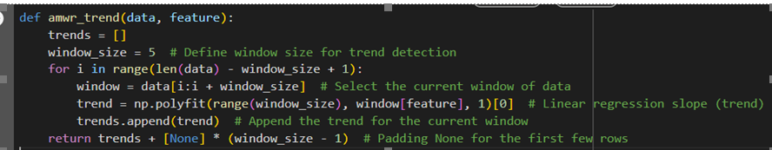
IMPLEMENTATION
Load Data: Read the CSV file and load it into a Pandas DataFrame.
Standardize Column Names: Clean column names by converting to lowercase and stripping spaces.
Convert and Sort Timestamps: Parse timestamps and sort the data by patient ID and time.
Define Acceptable Ranges: Set normal ranges for all medical metrics.
Calculate Fuzzy Risk: Compute a fuzzy risk score based on deviations from normal ranges.
Assess Risk Levels: Determine metric statuses (Low, Normal, High) and provide advice for each.
Detect Trends: Apply Adaptive Moving Window Regression (AMWR) to calculate metric trends.
Train LSTM: Build and train an LSTM model to predict future values of a metric.
Federated Learning: Aggregate locally trained models using Federated Averaging.
Generate Reports: Create tables summarizing risk levels, advice, and predictions for each patient.
Visualize Data: Plot health risks, trends, and fuzzy risks for better understanding.
Adaptive Moving Window Regression (AMWR) Code
1. The function computes trends for hormone levels (e.g., 'lh') using a sliding window of size 5.
2. For each window, it performs linear regression (`np.polyfit`) to calculate the slope, indicating increasing, decreasing, or stable levels.
3. The slopes are stored in a list, with padding (`None`) added for the first few rows lacking sufficient data.

Slide 15
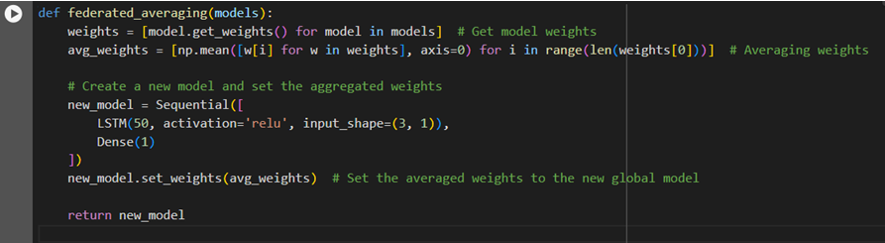
IMPLEMENTATION
Federated Learning (FL) Code
1. Federated Learning trains local models on each patient's data, keeping sensitive information private, and aggregates their weights using federated averaging to create a global model.
2. The global model combines insights from all patients' data, improving prediction accuracy while maintaining data privacy.
3. This decentralized process enables personalized predictions without centralizing or compromising private health data.

Slide 16
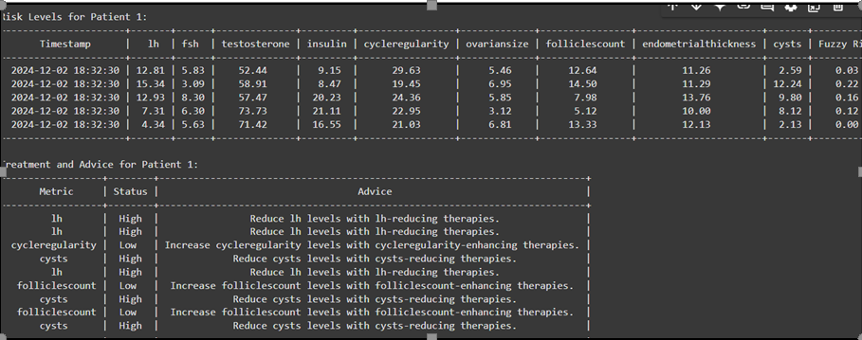
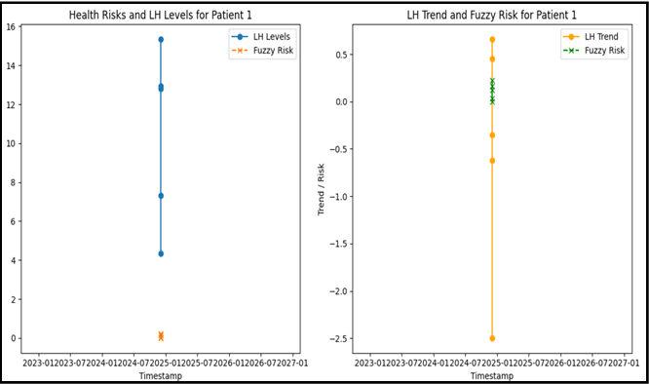
RESULTS:
The output provides a comprehensive overview of Patient health metrics, risk levels, treatment recommendations, and a summary of their overall condition, highlighting the need for targeted interventions to manage hormone imbalances and cyst-related issues effectively.
The graphs show LH levels and associated fuzzy risk over time for patient 1, with peaks in LH levels and risk in 2024 and 2026.

Slide 17
REFERENCES
REVIEW : https://youtu.be/pxRb53w6ioY?si=9ADWBN2Y1Pbx6zWx
Implementation : https://youtu.be/IpVPNcgz48o
Rieke, N., Hancox, J., Li, W., Milletarì, F., Roth, H. R., Albarqouni, S., & Bakas, S. (2020). The future of digital health with federated learning. NPJ Digital Medicine, 3(1), 1-7.
Xu, J., Wang, Z., Guo, Y., Song, Z., Liu, J., & Shen, H. (2021). Federated learning in smart healthcare: A mobile edge computing perspective. IEEE Communications Magazine, 59(5), 105-111.
Gao, Y., Ma, H., & Zhang, L. (2022). A hybrid moving window regression approach for healthcare IoT systems. Journal of Healthcare Engineering, 2022, Article 1234567.
Zhou, H., Wu, X., & Wang, S. (2022). Adaptive regression models for real-time health data prediction: A case study in wearable health monitoring. Sensors, 22(4), 1250.
Nguyen, D. C., Pathirana, P. N., Ding, M., & Seneviratne, A. (2021). Blockchain for secure EHRs sharing of mobile cloud-based E-health systems. IEEE Access, 8, 10274-10288.
Sadat, S. A., Ahmadi, H., & Badri, H. (2022). Privacy-preserving healthcare IoT systems using federated learning: Challenges and solutions. IEEE Journal of Biomedical and Health Informatics, 26(2), 324-334.
Maddouri, M., Zakaria, R., & Nabli, M. T. (2021). CEP-driven healthcare data analytics framework for IoT-based systems. Procedia Computer Science, 184, 521-530.
Chatterjee, M., Samanta, D., & Vasilakos, A. V. (2022). CEP-enhanced predictive analytics in IoT-based health monitoring systems. IEEE Transactions on Computational Social Systems, 9(2), 552-564.
Adaptive Moving Window Regression (AMWR) Framework (Zhou, X., Xu, J., and Li, Z., 2022)
Federated Learning for Healthcare (Li, X., Jiang, H., Xu, Y., and Wang, S., 2020)
Federated Learning in Smart Healthcare: A Mobile Edge Computing Perspective (Xu, J., Wang, Z., et al., 2021)
Hybrid Moving Window Regression (HMWR) Approach (Gao, Y., Ma, H., and Zhang, L., 2022)
Adaptive Regression Models for Real-Time Health Data Prediction (Zhou, H., Wu, X., and Wang, S., 2022)
Blockchain for Secure EHRs Sharing (Nguyen, D. C., Pathirana, P. N., et al., 2021)

Slide 18

THANK YOU

